Slide 1
Water Information Management System (WIMS)
National Hydrology Project(NHP)
Ministry of Jal Shakti
Department of Water Resources, RD & GR

Slide 2
On Webinar Online WIMS Training Session (Surface Water and Ground Water)
National Hydrological Project(NHP)
Topic : User Management in WIMS
Date of Training : 13-08-2020
Venue: Online Webinar
Organised By : NPMU ,NHP, MOWR,TAMC & CWC
.

Slide 3
Trainer Name : Meet Kumar Agarwal
Designation : Test Lead
Department : TAMC- National Hydrological Project(NHP) Email Id : agarwalmeet@rediffmail.com, meetk@tekskillsinc.net Contact No : 9650866776

Slide 4
Welcome Note & WIMS Project Objective
.

Slide 5
WIMS URL WIMS Application URL- tamcnhp.com/wims/ Or use URL - https://www.indiawris.gov.in

Slide 6
User Management in WIMS

Slide 7
WIMS – Water Information Management System
User Management
User Management
User Permissions
Manage Users
Manage Roles
Create Users/ Edit Users
Create Roles/ Edit Roles

Slide 8
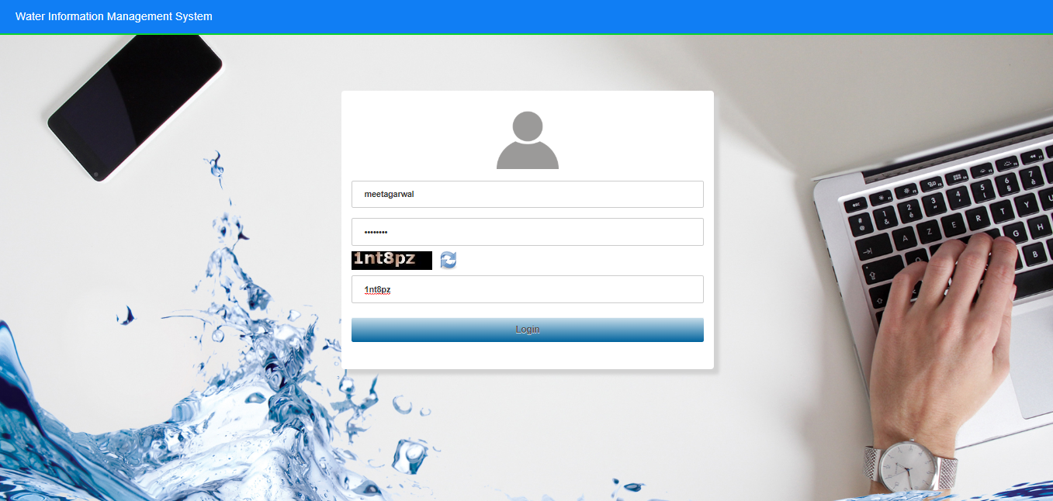
Login into WIMS (Water Information Management System) Enter Login, Password & Captcha details based on the User Agency. Click on Login button

Slide 9
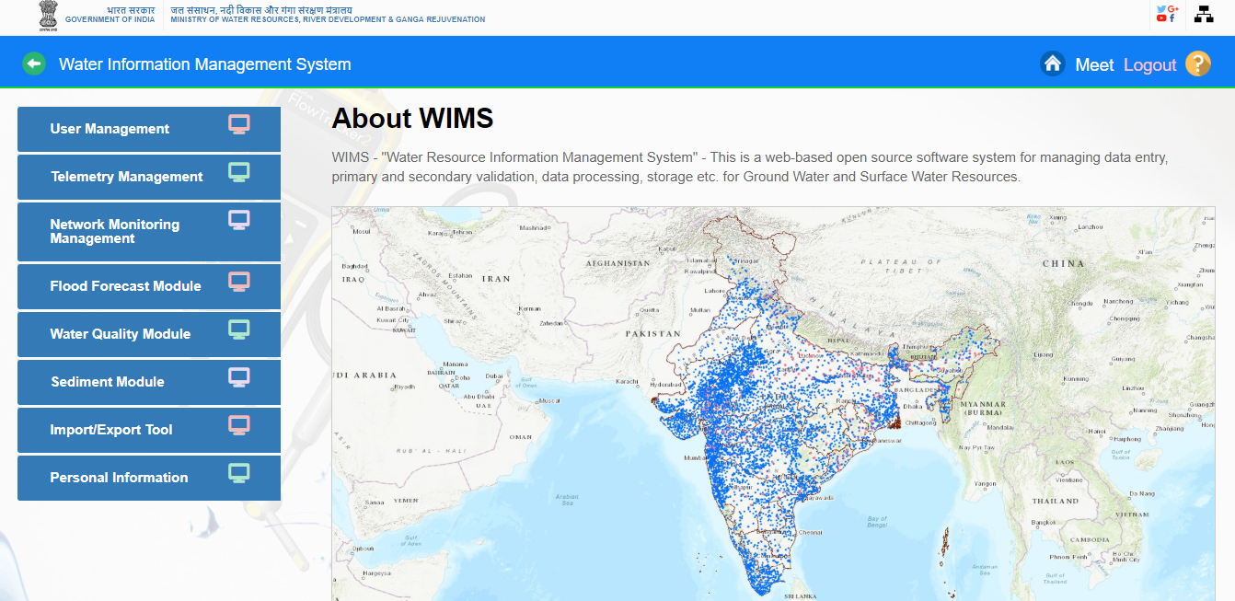
Home page of WIMS will be displayed on screen after login into WIMS application. User once done with the work can logout the session using the Logout Icon on the right top corner. Home Icon is to navigate back to the main page from sub modules page

Slide 10
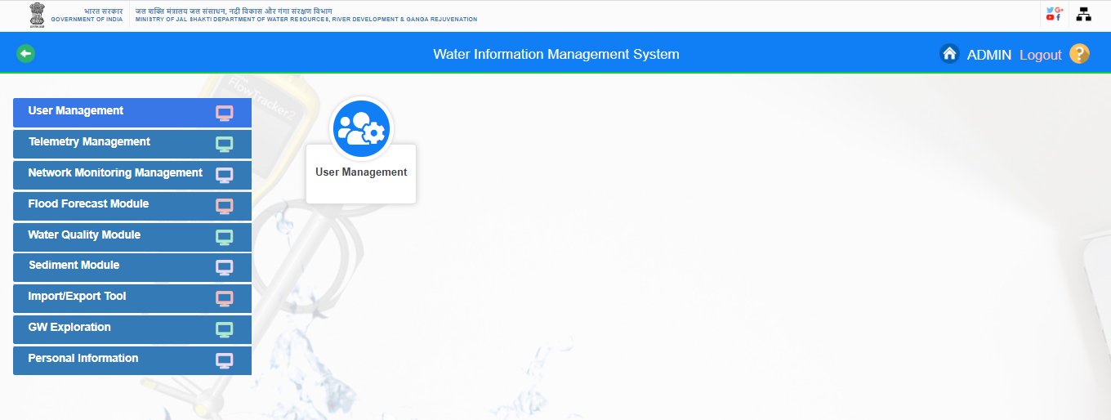
USER MANAGEMENT
In WIMS Total Number of Users : 860 , Number of Agencies : 49

Slide 11
USER MANAGEMENT
User: A person using application. This can by an employee or a contractor who is using the application. User Permission: Defined permissions assigned to a User. WIMS has following predefined permissions.
No Edit: The user has only view permission. Data Entry: The user has data entry permission. Permission level is (Data Entry+ View Only) Data In Charge: The user has data entry and validation permission. Permission level is (Data In charge + Data Entry View Only) Admin: A special User which has all permissions (edit / validate) on all modules. He can also create new users. Permission level is (Admin + Data In charge + Data Entry View Only) of Agency
Super Admin : Super Admin has the Super User Permission of WIMS on all agencies

Slide 12
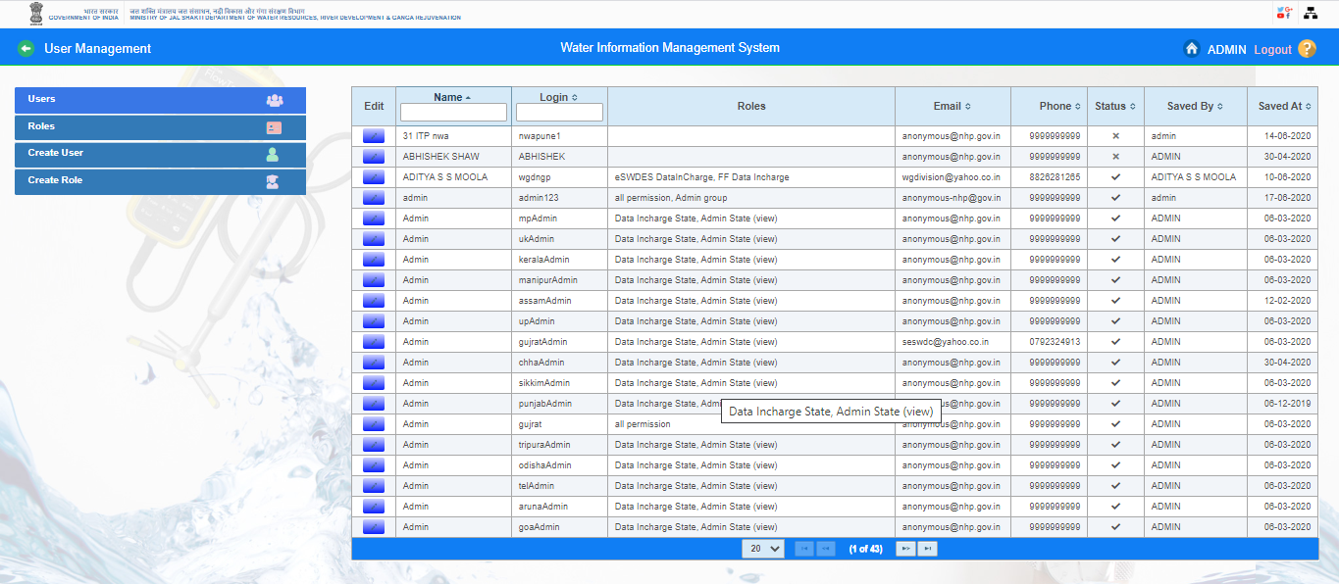
USER MANAGEMENT

Slide 13
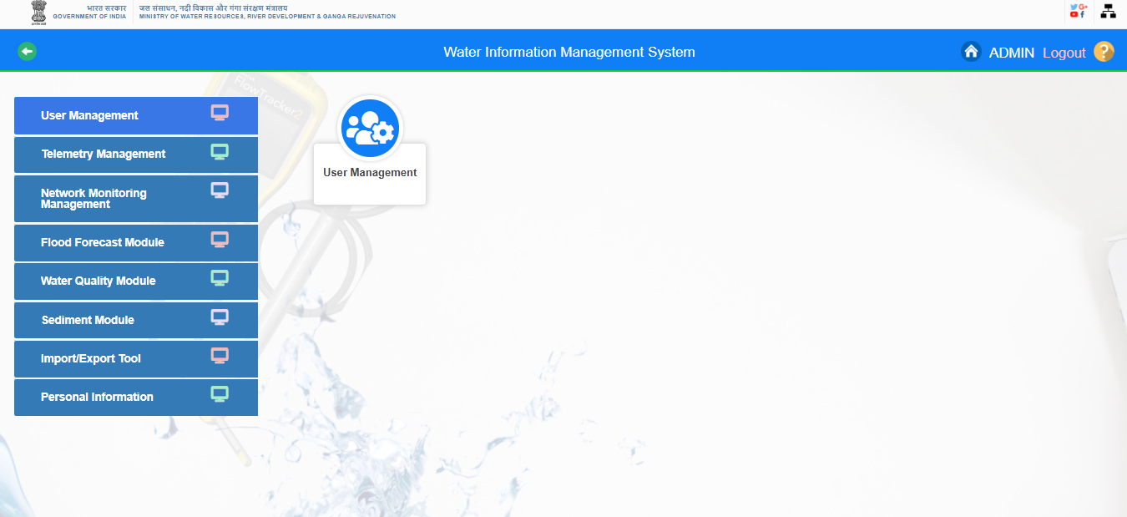
Click on “User Management “Navigator button. User Management icon is displayed on screen

Slide 14
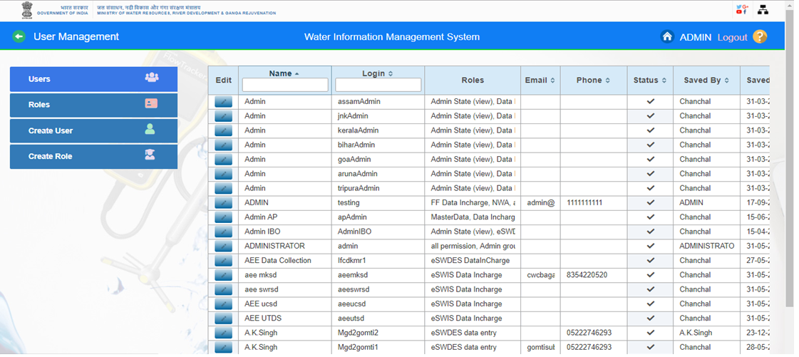
Users: Click on “Users” button on User Management page. All the existing users are listed on screen.

Slide 15
Roles : Click on roles button on User Management page. All the existing roles are listed on screen.

Slide 16
Create User: Click on Create User button. New User Creation Page is opened on screen.

Slide 17
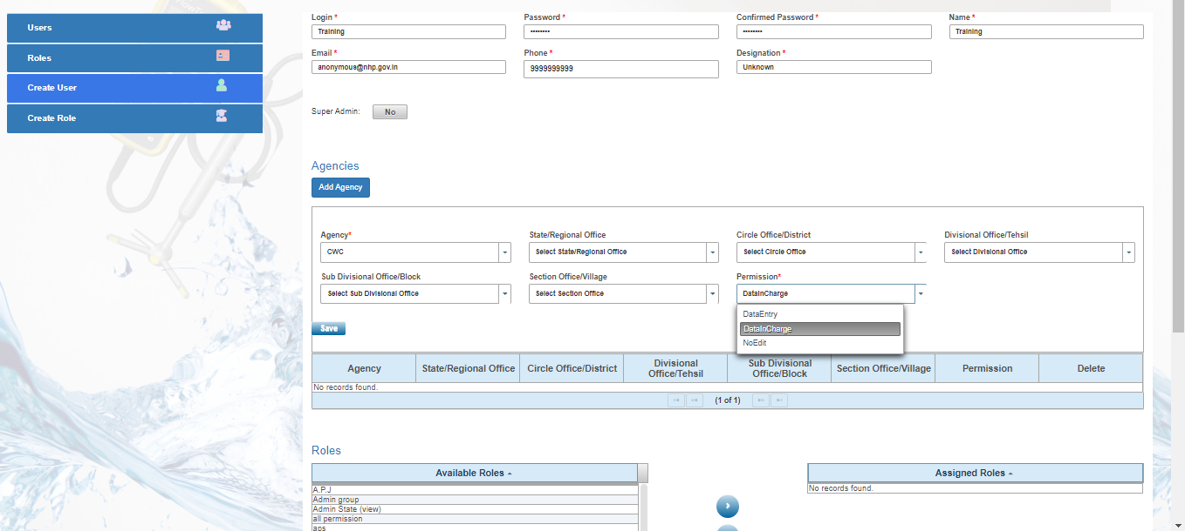
- Enter all the mandatory fields Login id , Password , Confirm password , Name, Email. Phone and Designation. -Add Agency & Permission: Select the agency , state/regional office, circle office/district, divisional office/tehsil, sub divisional office/block, section office/village and permission(Data Entry, Data Incharge, No Edit) to the user at the time of new user creation

Slide 18
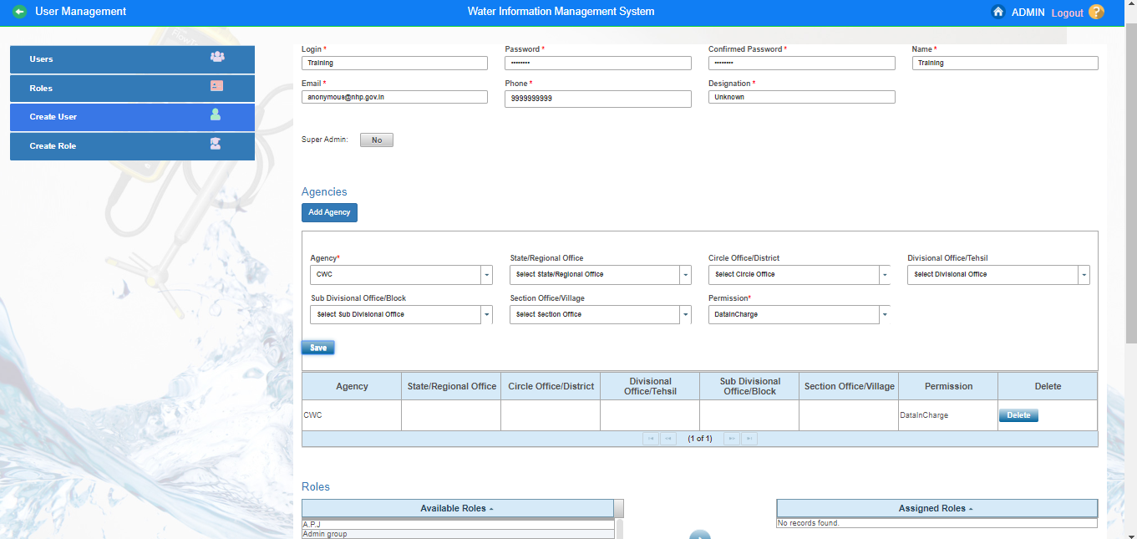
- Click on “Save “button to add the agency. Agency will be successfully added to particular user

Slide 19
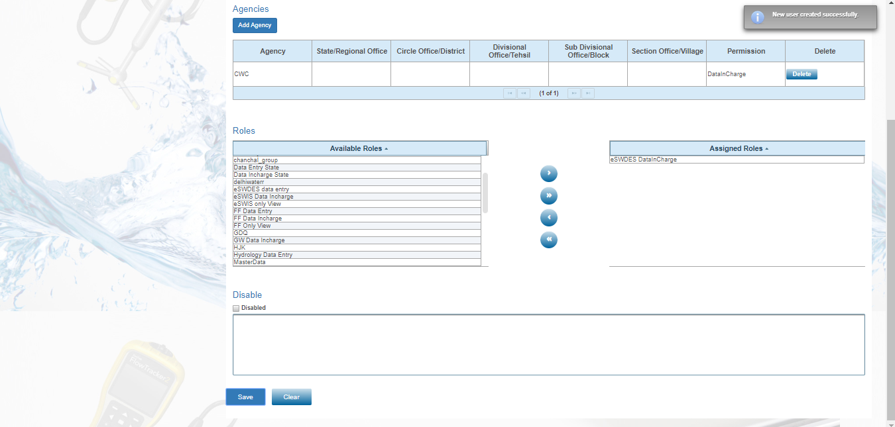
- Assigned Roles :Select the user role from available roles list and assign role to the user. - Click on “Save” button. User will be created based on agency permission and assigned role.” New User is created successfully “ is displayed on Screen. -Clear: If you want to clear the fields data, use clear button to clear all the details

Slide 20
Search User By Login Id/ Name : You can search the user by Login Id or Name. For Example- Enter the Login Id under login Id Column. WIMS application will automatically search out the user login id

Slide 21
Search User By Name: You can search the user by name. Enter the name under name Column. WIMS application will automatically search out the user name

Slide 22
Edit Existing Users: Search by user id or name. User will be listed on user management page. Click on edit button. User’s Information page is open in edit mode. Admin can edits the user ‘s details or change the password from this screen

Slide 23
After clicking on “Save” button. User ‘s details are saved/updated successfully and popup message is displayed “ user saved successfully “ on screen. Application allows user to return on users list page on screen

Slide 24
Create Role : Click on Create Role button. New Role Creation Page is opened on screen.

Slide 25
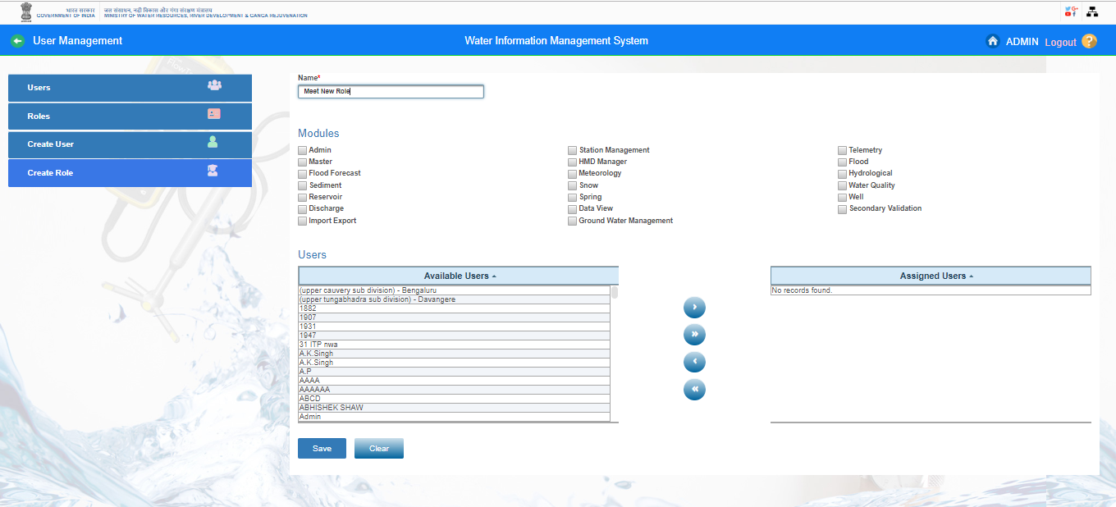
Enter Role Name in respective field on Role Creation Page

Slide 26
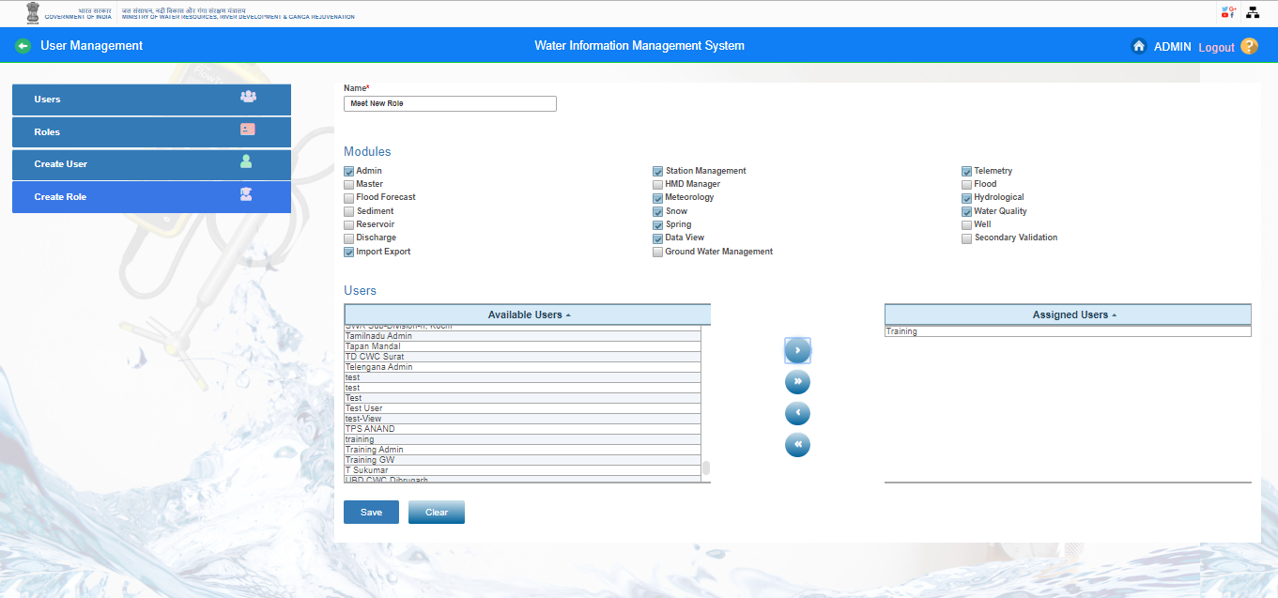
Select Modules: Select the modules on which you want to give the access. Select Users: Select the user from “Available list” and add that user in Assigned Users list.

Slide 27
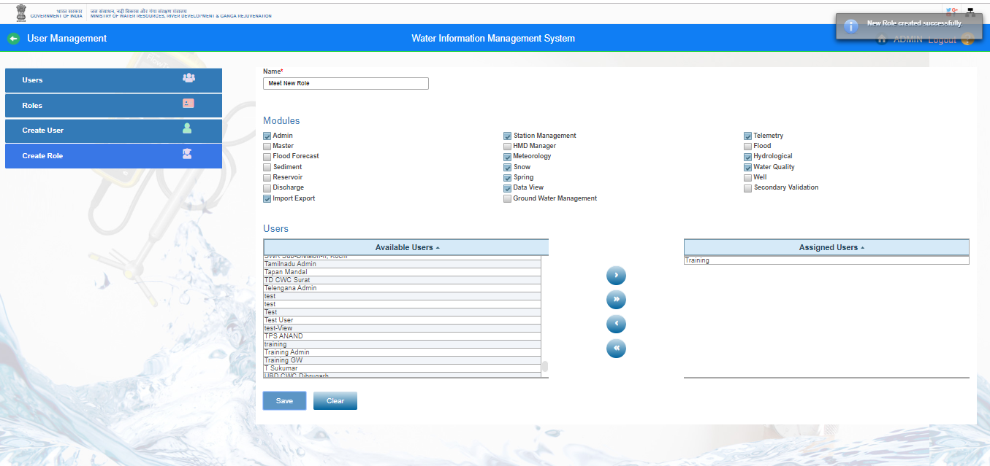
Click on “ Save” button. Popup message “ New Role is created successfully” is displayed on screen

Slide 28
Search Role by Name: Enter the Role Name in Name column. User’s Role is listed on roles page

Slide 29
Edit Existing Roles: Click on edit icon for editing or updating any user’s Group details of Role. User can either search or view listed user role’s. Click the Edit button for editing any user role.

Slide 30
User can edit the role’s details and click on Save button to update role information. Popup message is displayed as “Role Saved Successfully” and application returns to Roles list page

Slide 31
Questions and Answers with Feedback

Slide 32
THANK YOU

